Slide 1
Leprosy Screening through Image Processing Methods
Authors & Affiliations:
Pratham Agrawal¹, Anmol Anand¹, Devansh Mishra¹, Mehul Sharma^{1#}, Sathish Paul², Jeninth Mohan², Ester Rita², Dheeba J.¹, Kalairassan^{1#}, Saritha Murali¹, Biji C. L. ^{1*}
1: School of Computer Science and Engineering, Vellore Institute of Technology, Vellore
1#: School of Mechanical Engineering, Vellore Institute of Technology, Vellore
2: Schieffelin Institute of Health – Research & Leprosy Centre, Karigiri
*Corresponding author(biji.cl@vit.ac.in)

Slide 2
Topics of Content
Motivation | 3
Keywords | 3
Introduction | 4
Methodology – Dataset Abstraction | 6
Methodology – Methods Adopted | 8
Methodology – Thresholding | 9
Methodology – Contour Detection | 10
Results | 11
Conclusion | 14

Slide 3
Motivation
Research Question –
Can the latest Machine learning techniques be used to predict the type of leprosy by analysing skin lesion images ?
The goal of this paper is to give an accurate bacteria count in a skin lesion image.
We do this by utilising large amounts of past records to automatically detect any patterns or correlations.

Slide 4
Introduction
Leprosy caused by Mycobacterium leprae (M. leprae) is progressive bacterial infection but is curable [1]. Although the prevalence of this disease has significantly gone down after the introduction of the WHO regimen of Multi-drug Therapy (MDT) [2], the incidence remains still a concern.
Very recently, the high incidence is reported in various states on India, despite advances in all spheres of medical sciences. Statistic by NLEP shows 76% of new leprosy cases in some parts of India which includes children between the ages of 1 to 18 years. Based on the reports from all states by NLEP, a total of 57,672 leprosy cases are on record as on 2021. The report says, the child cases detected in 2021 were 1616 [3]. Figure 1 shows the prevalence of leprosy in India for the year 2020 and 2021.
In this paper, the bacilli count is performed using contour detection and compared with thresholding mechanism. The performance of these methods are computed based on purity calculation.
Figure 1. Statistics of Leprosy in India collected by NLEP [3]

Slide 5
Methodology - Data Set Abstraction
The data for this study is collected from the Schieffelin Institute of Health – Research & Leprosy Centre, Karigiri, Vellore. 44 retrospective data from the Pathology department were collected. Each image was graded according to the Bacillary index by the pathologist.
The stained tissue sections were observed under Olympus BX 50 Trinocular microscope. All skin smear sections were screened under 100x objective. Bacteriological index was calculated under oil immersion filed.
It is graded in Ridley’s logarithmic scale from 0 to 6+ as shown below in the table [14]. Pathologist carries out the examination of smear based on its morphology for instance, M. leprae are pink rod-shaped organisms.
The presence of bacilli is seen as pink rod precipitate against a blue background. If no bacilli are found, the smear is called negative else positive and are graded.
An example of an image from each level is shown on the next slide.

Slide 6
Methodology - Data Set Abstraction (Continued)
Above Figure shows the Image of smear level 3
Above Figure shows the Image of smear level 4
Above Figure shows the Image of smear level 5
Above Figure shows the Image of smear level 6

Slide 7
Methodology - Methods Adopted
The study focusses in understanding how the boundary detection in smear images will be successful for bacterial counting. Bacteriological Index is a key factor considered in determining the choice of treatment for a patient diagnosed with leprosy.
Hence in this paper an attempt is to made to estimate the bacterial count an important determining factor in the choice of treatment regimen which is based on the clinicopathological type.
The workflow consists of two methods
Thresholding
Contour Detection.

Slide 8
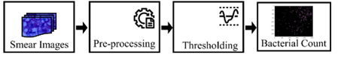
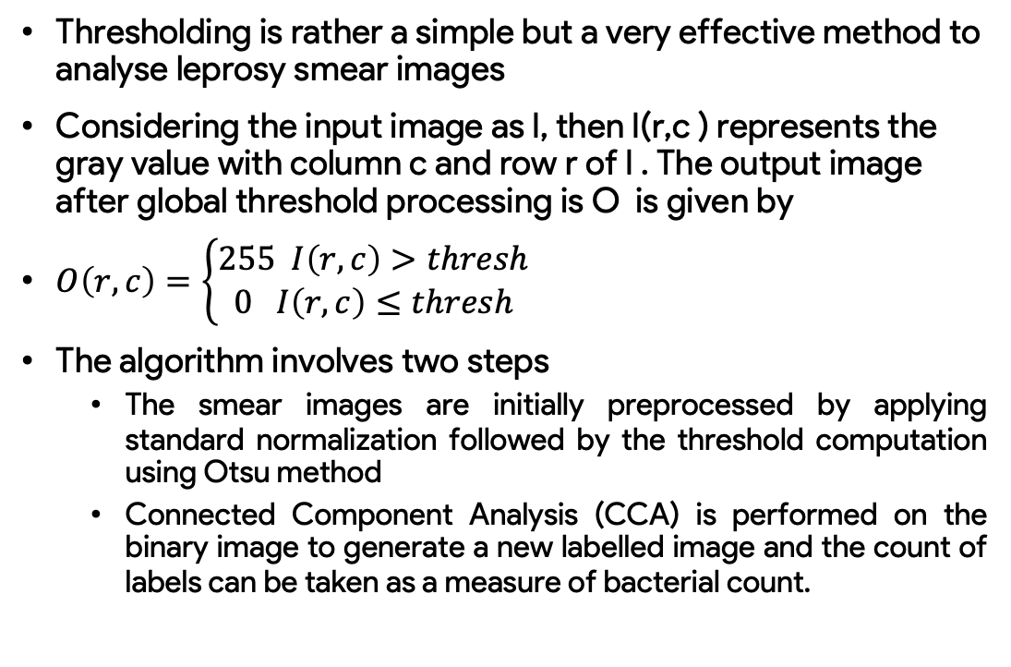
Methodology - Thresholding
Thresholding is rather a simple but a very effective method to analyse leprosy smear images
Considering the input image as I, then I(r,c ) represents the gray value with column c and row r of I . The output image after global threshold processing is O is given by
$O\left(r,c\right)=\left\{\begin{aligned}255 I\left(r,c\right)>thresh \\ 0 I\left(r,c\right)≤thresh\end{aligned}\right.$
The algorithm involves two steps
The smear images are initially preprocessed by applying standard normalization followed by the threshold computation using Otsu method
Connected Component Analysis (CCA) is performed on the binary image to generate a new labelled image and the count of labels can be taken as a measure of bacterial count.
Figure 2: Steps involved the bacterial counting using Global Threshold Segmentation

Slide 9
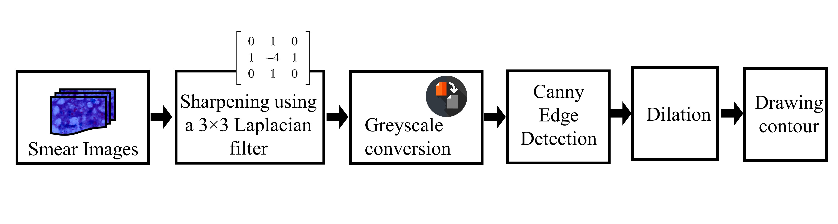
Methodology - Contour Detection
Figure 3: Steps involved the bacterial counting through contour detection
The input image is initially passed through Image sharpening Laplacian filter. This will sharpen the region of interest such as edges and corners, while suppressing areas with slowly varying intensity. The Laplacian filter can be implemented using various kernel sizes, and the size of the kernel will affect the degree of smoothing and noise reduction in the resulting image.
After filtering a binary edge map is produced.
During the next stage, the sharpened colour image will be converted to gray scale.
In order to extract the bacterial region (pink), canny edge filters with methods relevant to the morphology of bacteria was used.
The Canny algorithm uses a series of steps to detect edges, which are defined as the boundaries between regions of contrasting intensities in an image.
These steps included are shown in Figure 3.

Slide 10
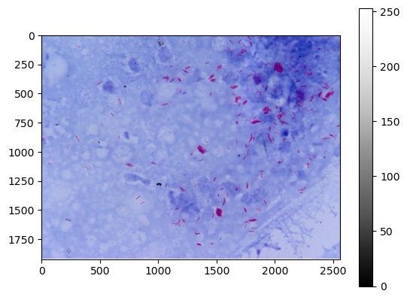
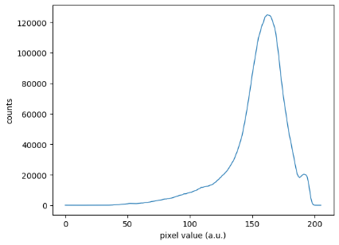
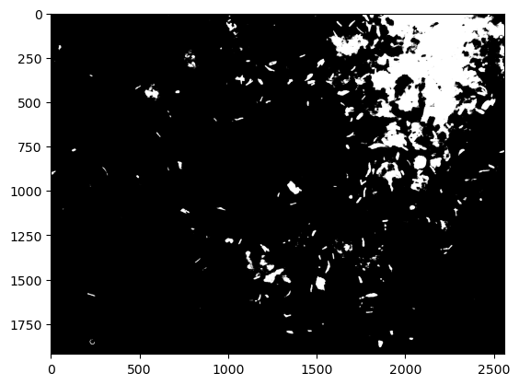
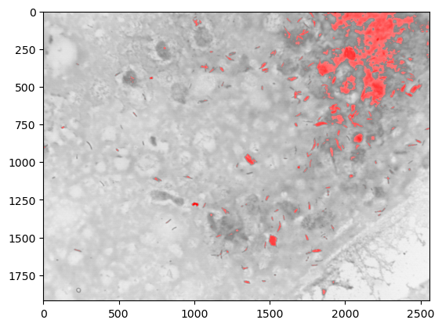
Results
It can be seen from the figure that the contour processing results are better than the global threshold segmentation method, which can completely segment the foreground and background and distinguish the target objects in the figure and could provide a reliable bacterial count.
Figure 5 shows the results of Global thresholding method and its end results.
Figure 5: Global Threshold Segmentation (a) Original Smear Image (b) Histogram of the image (c) Binary segmented Image after thresholding (d) RGB image after segmentation

Slide 11
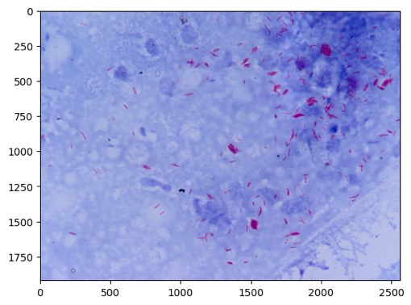
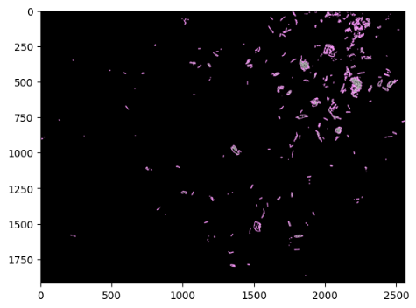
Results
Figure 6 shows the results of Contour Detection method and its end results.
Figure 6: Contour Detection (a) Original Smear Image (b) Sharpened Image (c) Contour Detected

Slide 12


Results
Figure 7 and 8 indicates the box plot for the bacterial count obtained after thresholding and contour detection methods.
For 3+grading category, the bacterial count range is from 82-909. 4+ grading category the range extended from 115-16712. 5+grading category the range is from 1743-2597 and 6+ category reported range from 6367-15966.
It has observed certain level of overlap in the bacterial count in different grading levels.
Colour inhomogeneity and low contrast resulted in outliers and overlapping of counts during the segmentation. The current works lacks in the standardisation of the automated bacterial counting.
In the future, we will work and propose a robust selective segmentation model to overcome the shortcomings
Figure 7: Bacterial Count obtained through global thresholding
Figure 8: Bacterial Count obtained through contour detection

Slide 13
Conclusion
Experimental evaluation demonstrates that the significance of automatic bacterial counting which indeed had a correlation to grading done by pathologist as per the bacteriological index.
The results are preliminary outcome of the hypotheses that require further in-depth validation to derive a mapping on Bacteriological Index.
Extensive validation is needed to make our system deployable for M. Leprae recognition applications

